Slide 1

Object Oriented Programing
Dr Palwasha Afsar
Lecture #1
Let’s explore and move
to “Better C”

Slide 2
Course Details

Slide 3
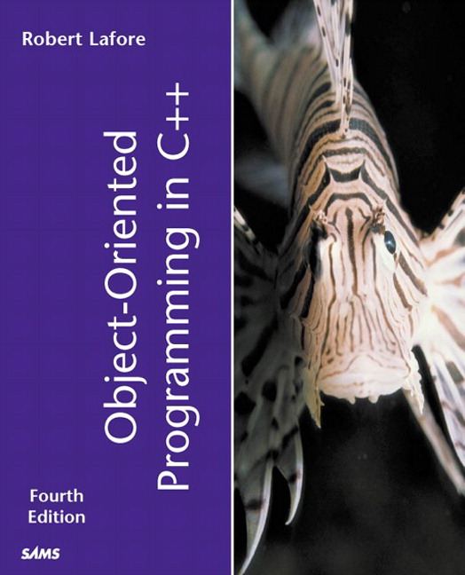
Text Book
OBJECT ORIENTED PROGRAMMING IN C++ by Robert Lafore, PEARSON, 4th Edition, (2013)

Slide 4
Course Assessment Model
Marks break up
Attendance 5
Assignments, Presentations, Quizes 15
Midterm 20
Final term 60
Total 100

Slide 5
Course objectives
To understand basic programming constructs and use the newly acquired skills to solve extensive programming problems.
To understand the principles of the object-oriented model and its implementation in the ‘C++' language.
To build on the concepts learned in C language and use the power of object oriented programming to develop software applications.
To enable the students to write and execute well structured 'C++' programs.
To use problem solving and program design techniques effectively to generate applications.

Slide 6
Programming Innovations
Simple programs in old days.
Complexity with time.
Prone to error, expensive and life threatening.
Object Oriented Programming (OOP)
The Unified Modeling Languages (UML)
Improved Software Development Process.

Slide 7
Object Oriented Programming
Why OOP has become the preferred language???
New and powerful
Deals with Objects and classes.
Clearer, reliable and easy to maintain.

Slide 8
The Unified Modeling Languages
Graphical language consisting of diagrams.
Helps analysts in understanding program design and work flow.

Slide 9
Languages and development platforms
C++ most widely used.
JAVA miss features like pointers, templates and multiple inheritance.

Slide 10

The hitch…
The BURNING questions in mind…
Oh no… Why another Programming Language ?
Limitation in older programming languages
What would we do with it, we already know C?
Two main concepts in OOP : Objects and classes
Will it really help improve my programming skills?

Slide 11
Limitations in current languages
Procedural languages
Executes a set of instructions
Suitable for small programs
Division into functions
Large programs, functions are used.
They are also referred as subroutines
Grouping functions together into modules.
This approach is common in structure
Programming.
Towards better programming….

Slide 12
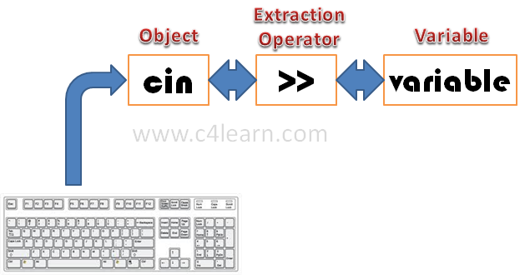
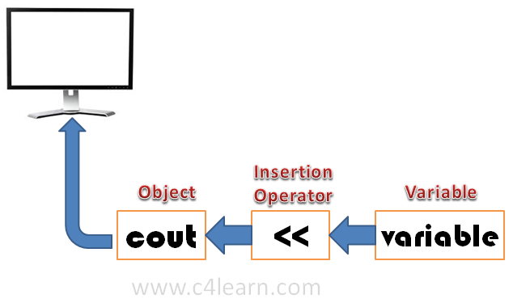
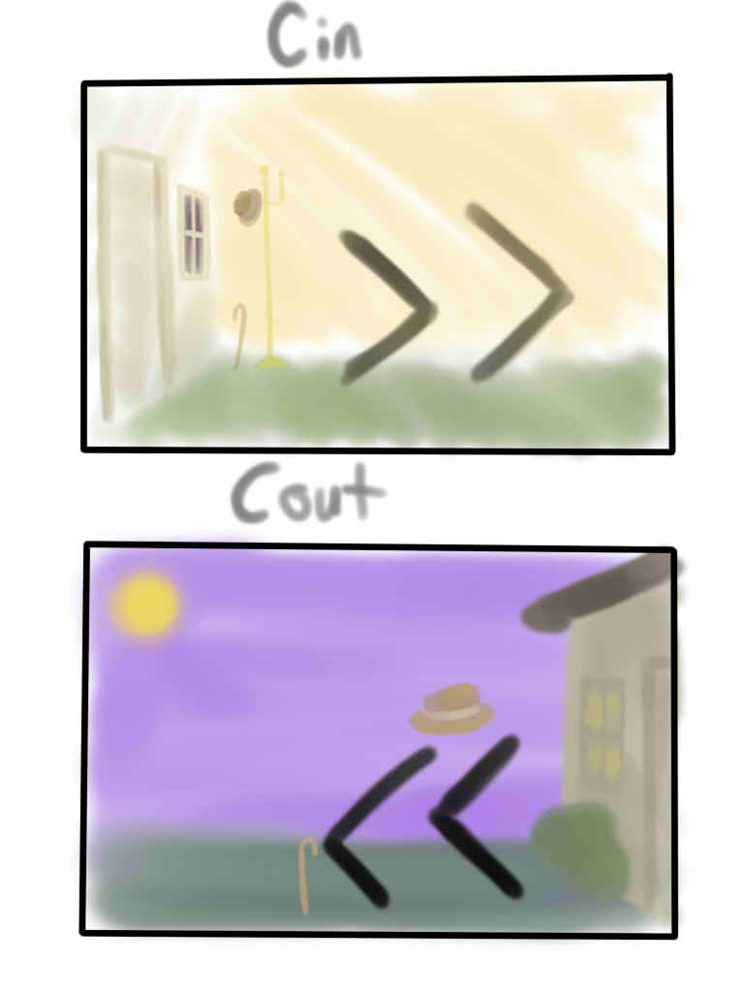
Procedural languages Input/Output
Bring in through cin and Take out through cout

Slide 13
Structured Programming
Larger programs, more complex, even structure programming is not the solution.
More programmers are added, cost is increased, complexity increases and schedule slips.
Functions have access to global data.
Poor modeling of real world.

Slide 14
Local and Global data

Slide 15
Multiple functions accessing data

Slide 16
Problems
Difficult to modify.
One change in global data will require subsequent changes in all of the functions e.g., change of food aisle
Real-world modeling:
In real world we deal with physical object e.g people, car etc with attributes and behavior.
E.g of attributes: eye color, job title, doors in cars etc

Slide 17

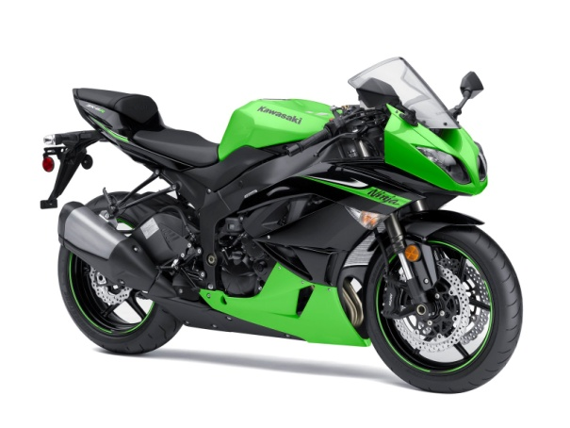
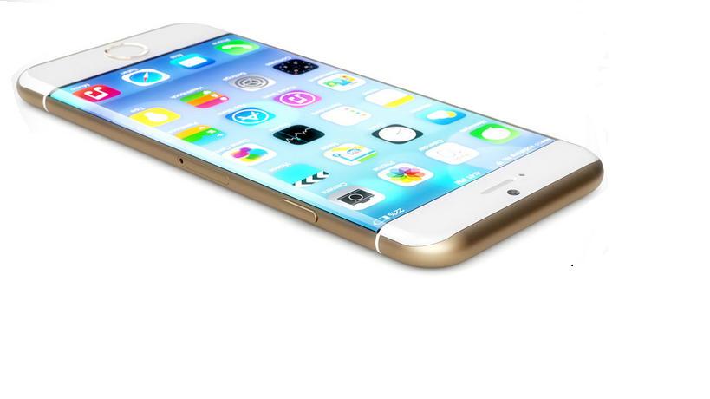
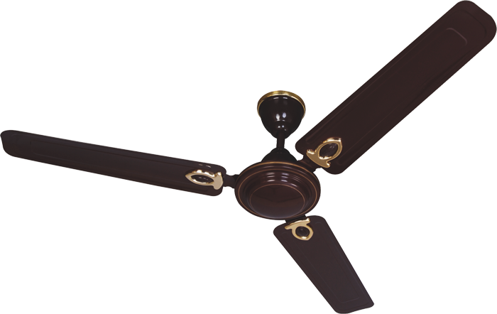
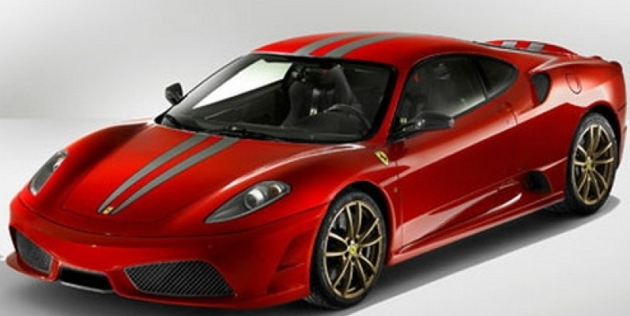
Example of Objects
Look around you and identify some objects
Everything is an OBJECT

Slide 18
Object ,Object and Object
A student, a professor
A desk, a chair, a classroom, a building
A university, a city, a country
A subjects such as Physics, Math, History, …

Slide 19
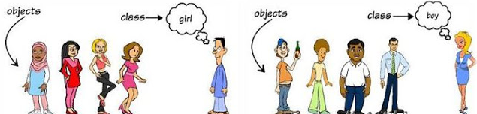
Daily Analysis
In real world, many objects are of same kind.

Slide 20
OOP Approach
OOP combines data and functions that operate on that data. Such unit is called an Object.
Data can be accessed only through functions called member fucntions in OOP.
Data is hidden inside and safe.
If you want to modify data, you kow which functions access it.
Objects are similar to departments.

Slide 23
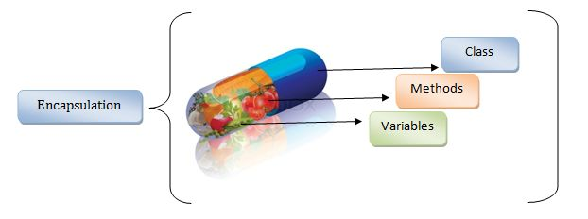
Encapsulation

Slide 24
Inheritance
But Mummy, where did my blue eyes come from?

Slide 25
Inheritance

Slide 26
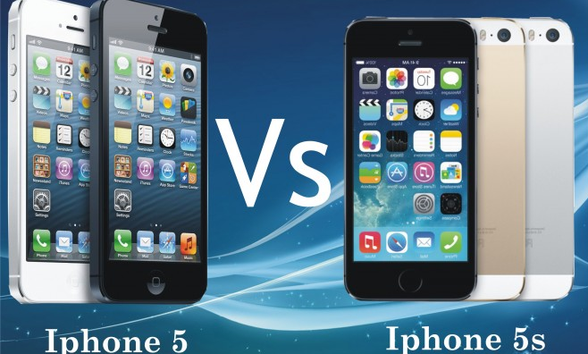
Reuse, Reduce & Reliable !!!
Existing Features
Existing Features + Additional Features

Slide 27
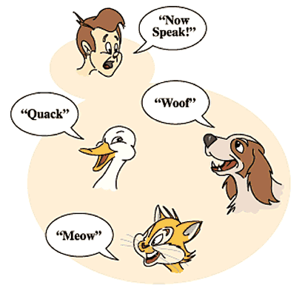
Polymorphism

Slide 28


Polymorphism
Using operators or functions in different forms is called Polymorphism. When an operator e.g., + or – is given the ability to operator on a new datatype it is called operator overloading.
In front of father
In class
One thing and many forms

Slide 29


Next Class: Concepts and Basics of C++ programming
Any Question?
cse202@lpu.co.in

